Slide 1

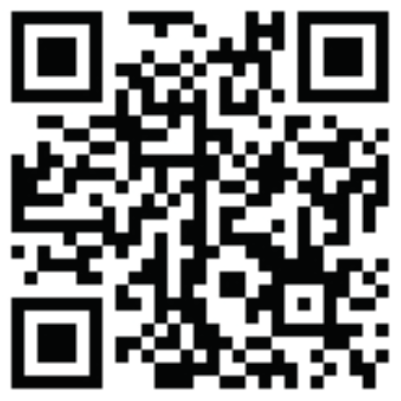


Your Voice Matters
Every time you attend a meeting, your experience helps make SMART Recovery meetings better—for you and others.
Completely anonymous
Takes about 2 minutes
You can share feedback anytime you attend
Not connected to any facilitator or specific meeting
Share your experience
https://p4g.to/SMART

